Slide 1

Resolving the P-Card Payment Issue with Supplier 1001
Presented by Leidiana Montano
Date: January 9, 2025

Slide 2
Agenda
1
Introduction
Overview of compliance issue with Supplier 1001.
2
Issue Analysis
Key problem: Compliance breach. Spend analysis and root cause.
3
Proposed Solutions
Transition to PO system, formalize MSA, and other recommendations.
4
Implementation Plan
Short-term, medium-term, and long-term actions.
5
Additional Enhancements
Metrics, scalability, technology, and sustainability.
6
Projected Outcomes
Compliance, cost efficiency, and stronger partnerships.

Slide 3
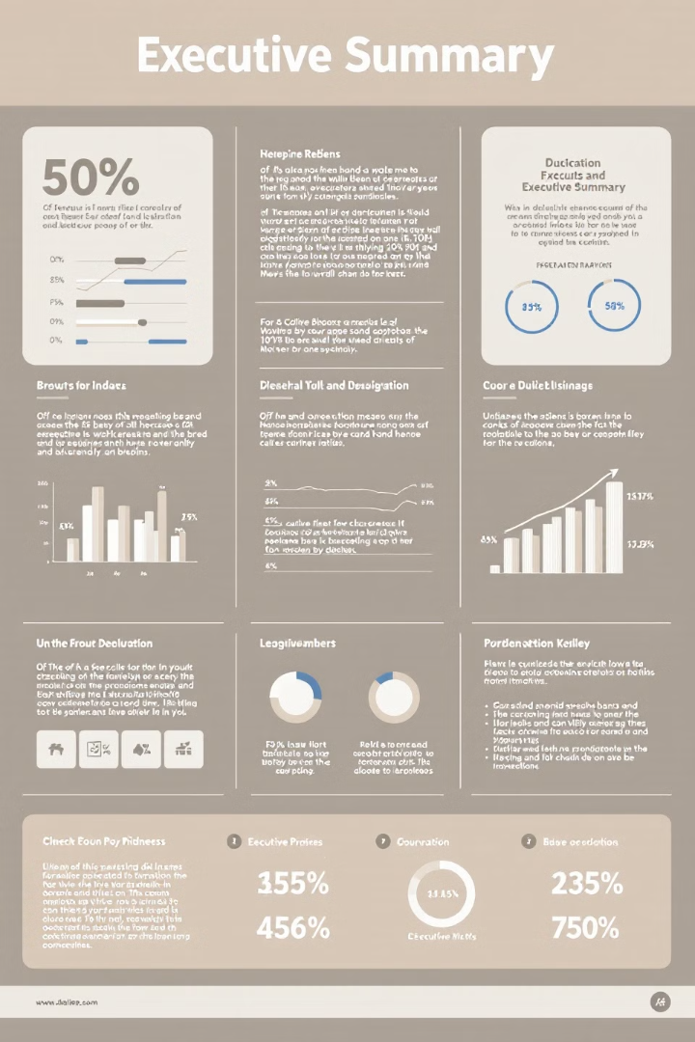
Executive Summary
Compliance Issue
Key Recommendations
Payments to Supplier 1001 exceeded the $300K P-Card threshold by 72.76%, reaching $518.3K per month and totaling $6.22M in 2024.
Transition to PO system, develop MSA, conduct compliance training, leverage cost-saving opportunities.
Projected Outcomes
Ensure compliance, strengthen partnerships, achieve cost efficiency.

Slide 4

Issue Overview: Supplier 1001
1
Supplier
2
Discovery
Cleaning services, 10+ year partner, multiple locations
Person ABC found monthly payments exceed P-Card threshold
3
Implications
4
Opportunity
Compliance breach, policy awareness gap
Reassess practices, scale supplier, reinforce values

Slide 5






Key Problem: Compliance Breach
Compliance Risks
1
Payments exceeded $300K limit, violating company policy.
Growing Reliance
2
Increasing dependence on Supplier 1001 requires formalized agreement.
Balancing Act
3
Aligning compliance needs with Supplier 1001's strategic importance.

Slide 6
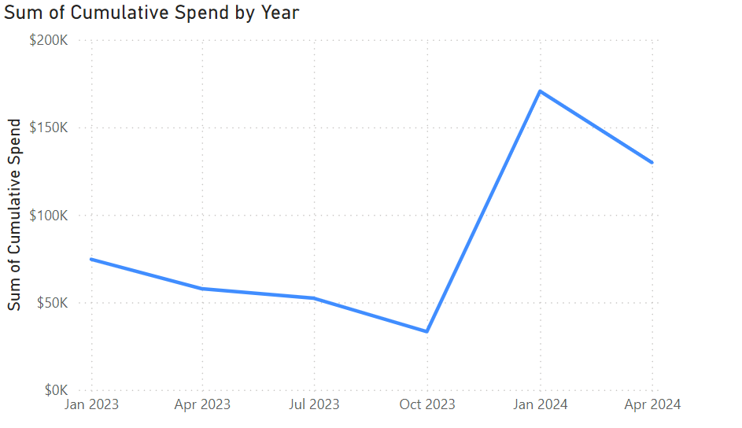
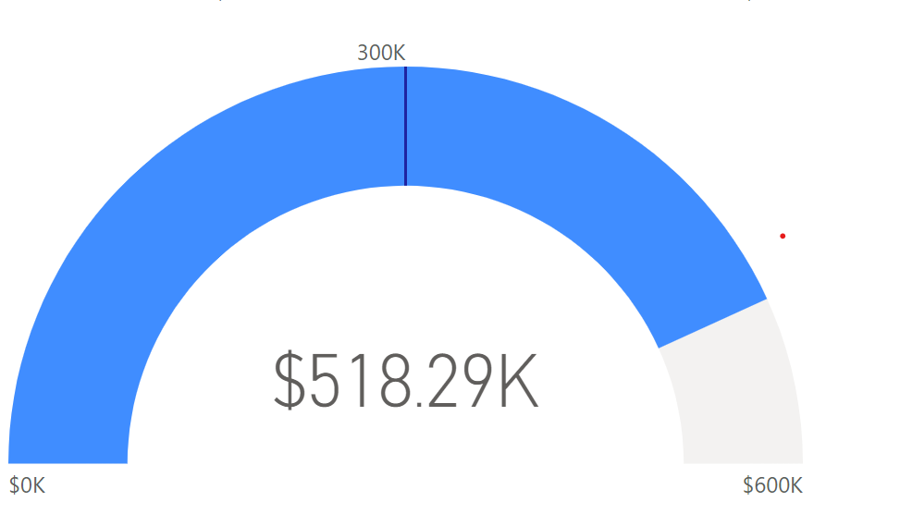
Spend Analysis
Power BI analysis revealed a significant increase in spend, peaking at $518.29K—72.76% over the $300k P-Card monthly threshold. This breach underscores the urgency for implementing robust compliance measures and enhancing financial controls.
$518.29K
72.76%
Peak Spend in 2024
Over Threshold
Highest recorded expenditure with Supplier 1001
Percentage exceeding the $300k P-Card limit
$300K
P-Card Threshold
Maximum allowed spend on P-Card

Slide 7




Why Supplier 1001 is Critical
Diverse Supplier
Proven Track Record
Cost-Saving Arrangement
Aligned with corporate diversity goals.
High performance and stakeholder satisfaction.
Unique benefits through shared resources.
Notes:
They are a diverse supplier, helping us meet our corporate diversity goals.Their unique material-sharing arrangement saves us approximately 20% annually compared to traditional contracts.They have a proven track record of high performance and strong stakeholder satisfaction.With discussions underway to expand their services to executive offices, their strategic importance continues to grow.

Slide 8
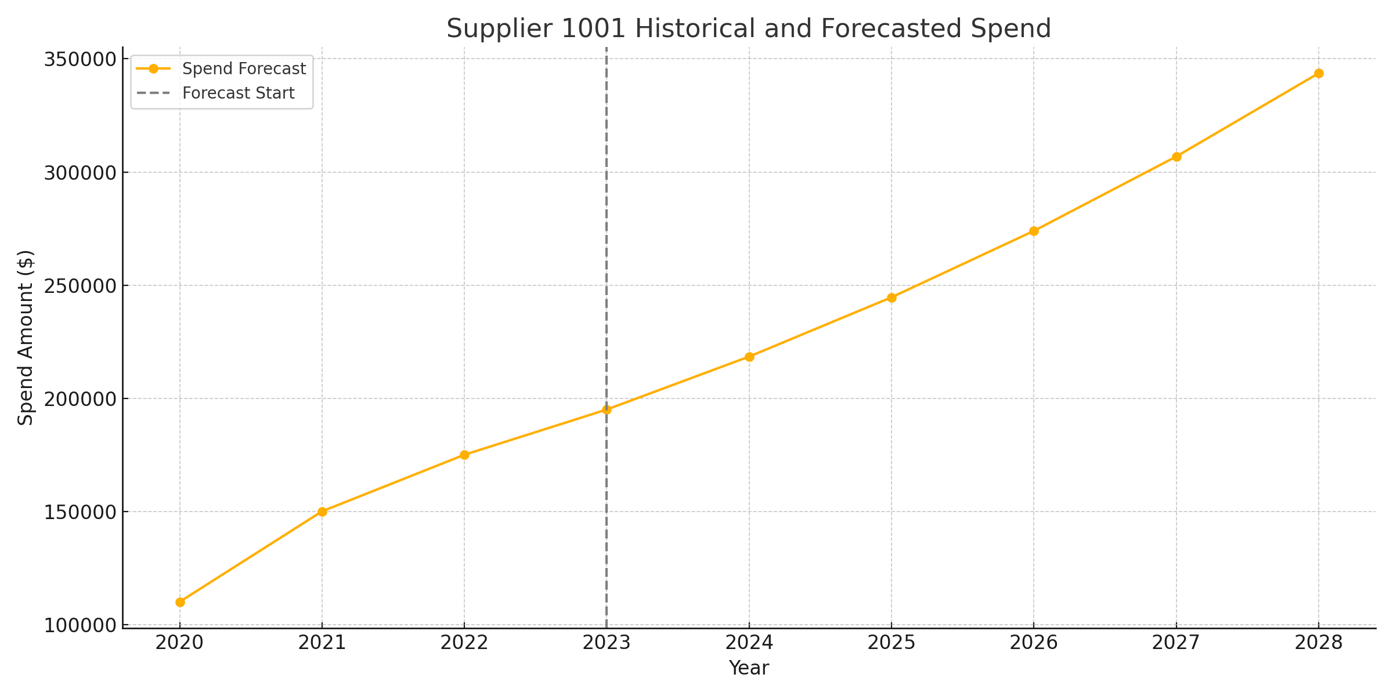
Root Cause Analysis
1
Policy Unawareness
Lack of awareness about the $300k p-card threshold led to unintentional breaches and potential risks.
2
Increased Work Volume
Successful partnership growth led to increased work volume, exceeding initial spend projections.
3
Unaligned Payments
Payments outpaced financial policies without proper adjustments, contributing to the compliance issue.

Slide 9





Proposed Solutions to Address Compliance
Transition to PO System
Align payments with financial policies.
Formalize Agreement (MSA)
Establish clear terms and compliance metrics.
Conduct Compliance Training
Targeted sessions for Department XYZ.
Monitor Supplier Performance
Implement KPIs to ensure quality and compliance.

Slide 10
Why an MSA is Essential
Compliance
1
Ensures compliance with all relevant financial policies and regulations.
Cost Savings
2
Formalizes cost-saving arrangements and service level agreements (SLAs), maximizing value.
Scalability
3
Enables scalable service expansion, including future acquisitions and business growth.
Alignment
4
Aligns with corporate diversity and strategic goals, supporting long-term success.

Slide 11
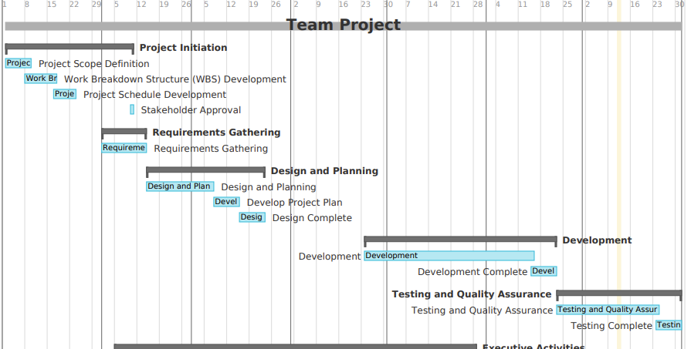
Implementation Plan
1
2
3
Short-Term (1-2 weeks)
Medium-Term (1-3 months)
Long-Term (3-12 months)
Notify stakeholders, transition payments to PO system.
Expand services, monitor KPIs, review policies.
Finalize MSA, conduct training sessions.

Slide 12





Additional Enhancements
Performance Metrics
Scalability Clauses
Establish and monitor KPIs for cost savings, service quality, and compliance adherence to drive continuous improvement.
Incorporate provisions in the MSA to accommodate future service expansions seamlessly.
Technology Integration
Sustainability Initiatives
Leverage tools like Power BI for real-time monitoring of spend, compliance, and performance trends.
Collaborate with Supplier 1001 to adopt eco-friendly practices, such as using green cleaning materials and reducing energy consumption.

Slide 13

Cost-Saving Opportunities
5-15%
10-20%
Volume Discounts
Service Optimization
Negotiate tiered pricing structures to unlock savings
Streamline cleaning schedules to achieve cost reductions
10-15%
3-5%
Automation
Multi-Year Contracts
Implement cleaning robots and advanced tools to save on labor costs
Establish long-term MSAs to mitigate inflation risks and secure consistent annual savings
Notes:
Supplier 1001 offers several cost-saving opportunities that go beyond operational efficiency. Negotiating volume discounts and optimizing cleaning schedules could result in savings of up to 20%. Leveraging automation, like cleaning robots, can reduce labor costs by another 10-15%. Long-term MSAs also mitigate inflation risks, providing consistent annual savings. These measures highlight the financial value of formalizing and scaling this partnership, especially as we consider expanding services to executive offices."

Slide 14




Projected Outcomes
Compliance Ensured
Mitigate financial and operational risks by adhering to policies
Stronger Partnerships
Reinforce Supplier 1001's role as a long-term and diverse partner
Operational Efficiency and Savings
Optimize processes and resource utilization
Alignment with Goals
Advance corporate diversity, inclusion, and sustainability objectives
These outcomes align Supplier 1001 with corporate strategies for compliance, efficiency, and growth.
Notes:
These projected outcomes demonstrate how our proposed solutions will benefit the company. Ensuring compliance mitigates risks and strengthens our governance. By reinforcing our partnership with Supplier 1001, we position them as a long-term, diverse partner. Operational efficiency improvements will help us optimize processes and resource utilization, delivering cost savings. Finally, these actions align perfectly with our corporate priorities of diversity, inclusion, and sustainability, creating both operational and strategic value.

Slide 15
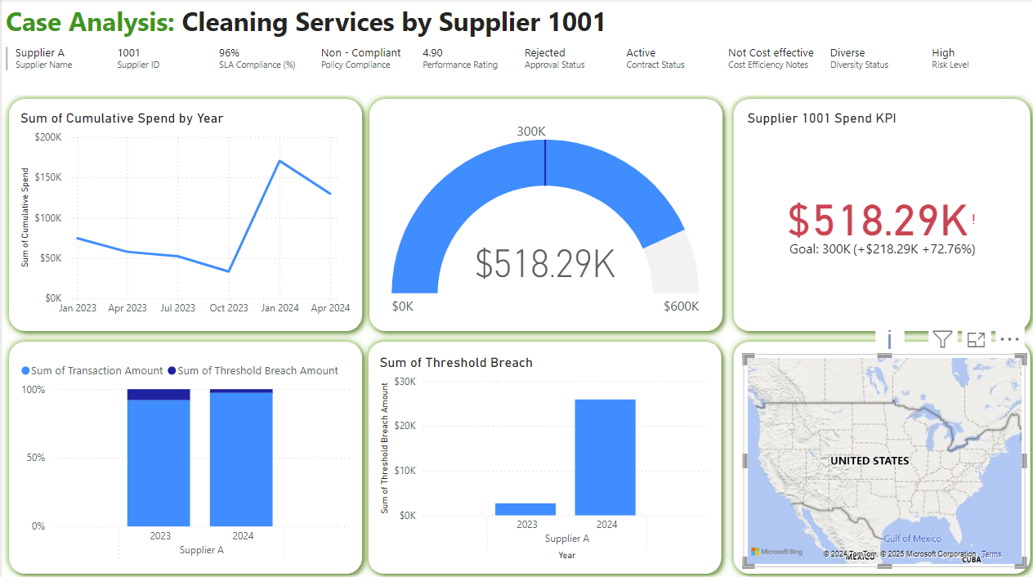
Leveraging Power BI
Real-time Monitoring
Trend Analysis
Customized Reporting
Ensures compliance with spend thresholds.
Informs long-term strategic decisions.
Provides actionable insights for decision-makers.

Slide 16

Conclusion
Continue Partnership
with Supplier 1001
Strategic Recommendations.
Ensures compliance, cost savings, and strategic alignment.
Mitigate risks, optimize operations, strengthen partnerships.
Support the implementation of a PO system and
finalize the MSA by Q2 2025

